Slide 1
Salary Prediction App
Presenter: Munyee

Slide 2

Introduction
In this age and time, many job seekers often mislooked the importance of better salary negotiation skills even when they already passed numerous interviews and tests.
This remorse only comes after the candidate has joined the company which is a little too late.
Thus, the focus of this capstone is to close the gap between salary expectations from candidates and hiring companies salary allocation.

Slide 3

Problem Statement
Bridging the gap between Job seekers and Hiring Companies
Reduce the salary negotiation gap for job applicants and hiring companies.
2. Develop a model to predict Salary
Identify the best model to better predict salary ranges for potential job seekers based on their resume or cv.
3. Identify top features and build an application to predict salary
Determine the top features to improve the model and deploy in a flask application.

Slide 4
EDA

Slide 5
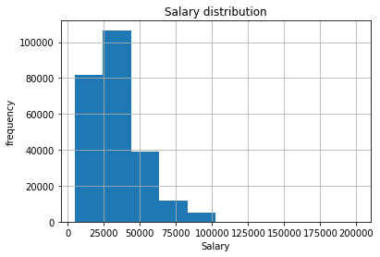
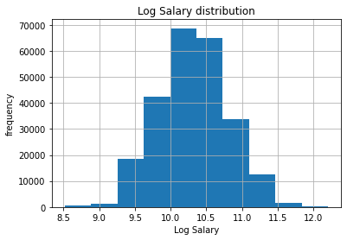
Feature Engineering
Feature Engineering
Salary skewed to the right.
Obtained Log salary to get normal distribution.

Slide 6
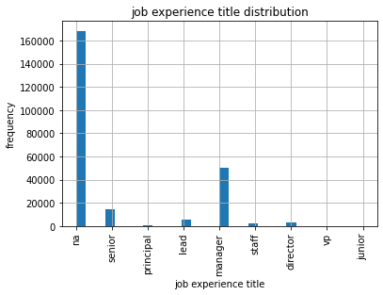
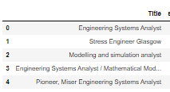
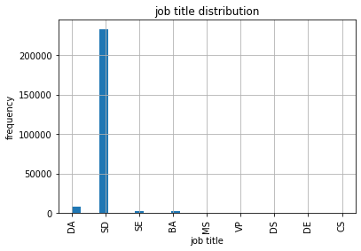
Feature Engineering
Seniority function
Simplified Title function

Slide 7
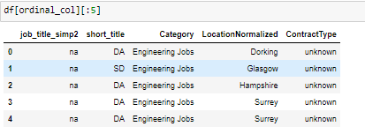
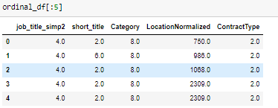
One-Hot encoding (categorical features)

Slide 8
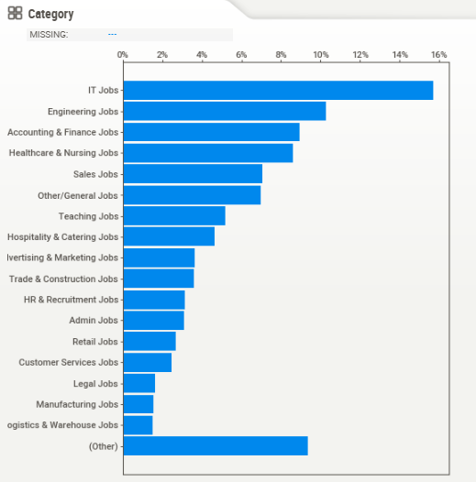
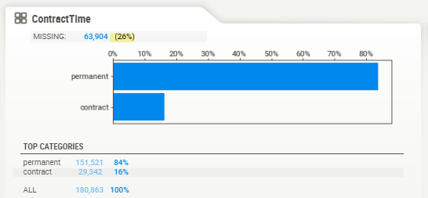
EDA
Looking at the frequency of data, there are more found in the IT sector and engineering jobs.
Permanent job entries are also more frequent.

Slide 9
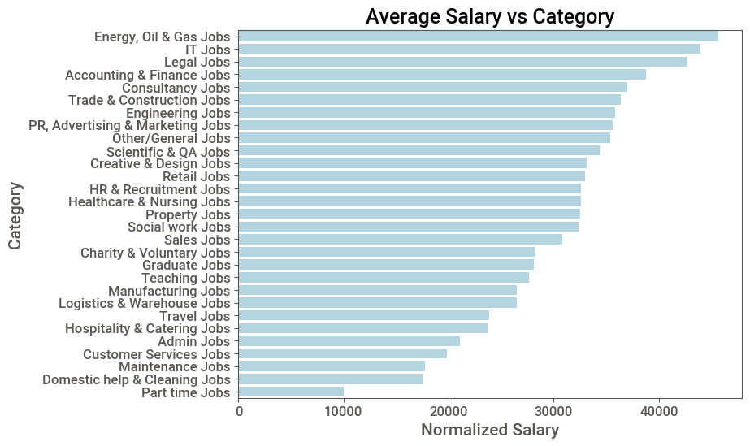
EDA
We can see industries like Energy/oil/gas, IT, legas and finance topping the charts for salary offers.

Slide 10
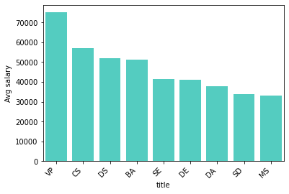
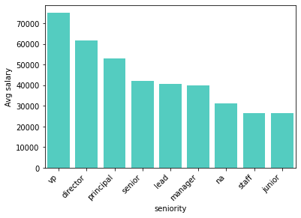
EDA (Job title)
The Salary also trends well with seniority like Vice president, directors, principal scientist/engineers get paid the most. This is followed by positions like Comp Science → Data Scientist → Business Intelligence Analyst.

Slide 11
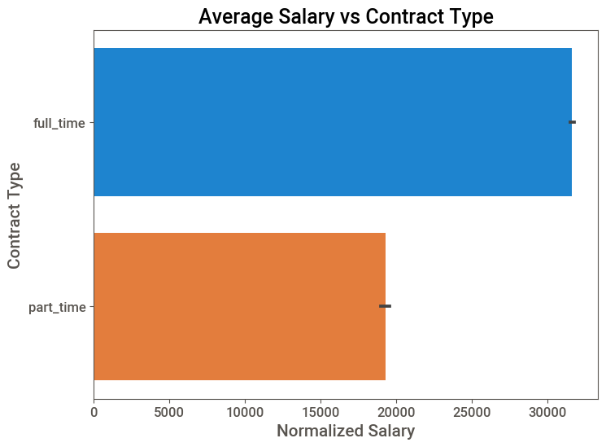
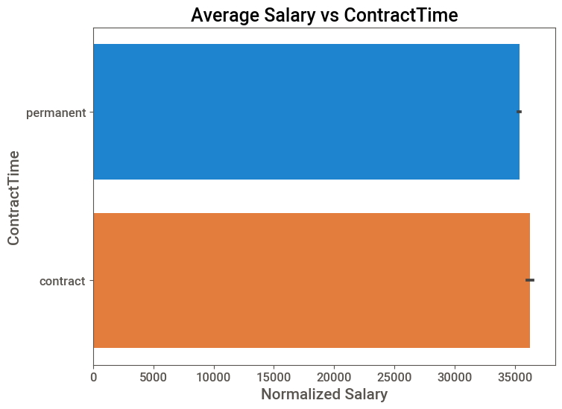
EDA (Contract type)
From the EDA, its also observable that parttime gets paid lower compared to full time contract but contract time shows a different trend whereby contract is paid more than permanent.

Slide 12
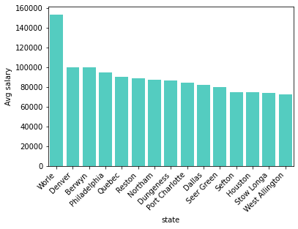
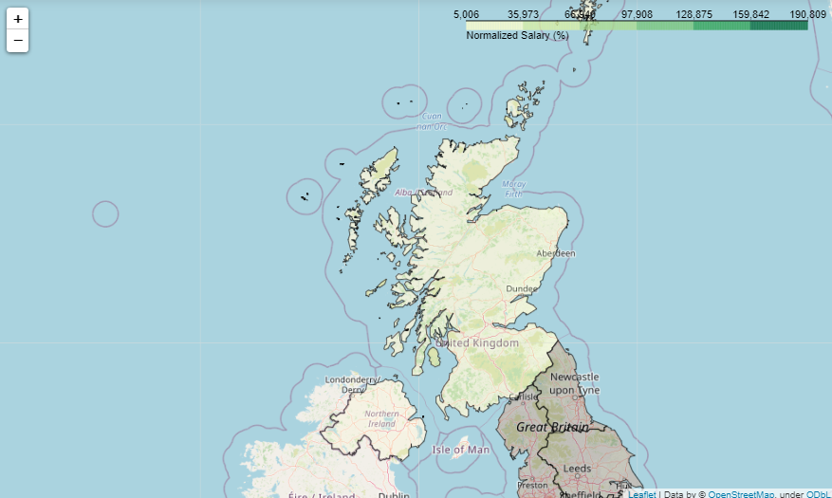
EDA
The location also plays a big role, like Worie and denver gets the highest pay.

Slide 13
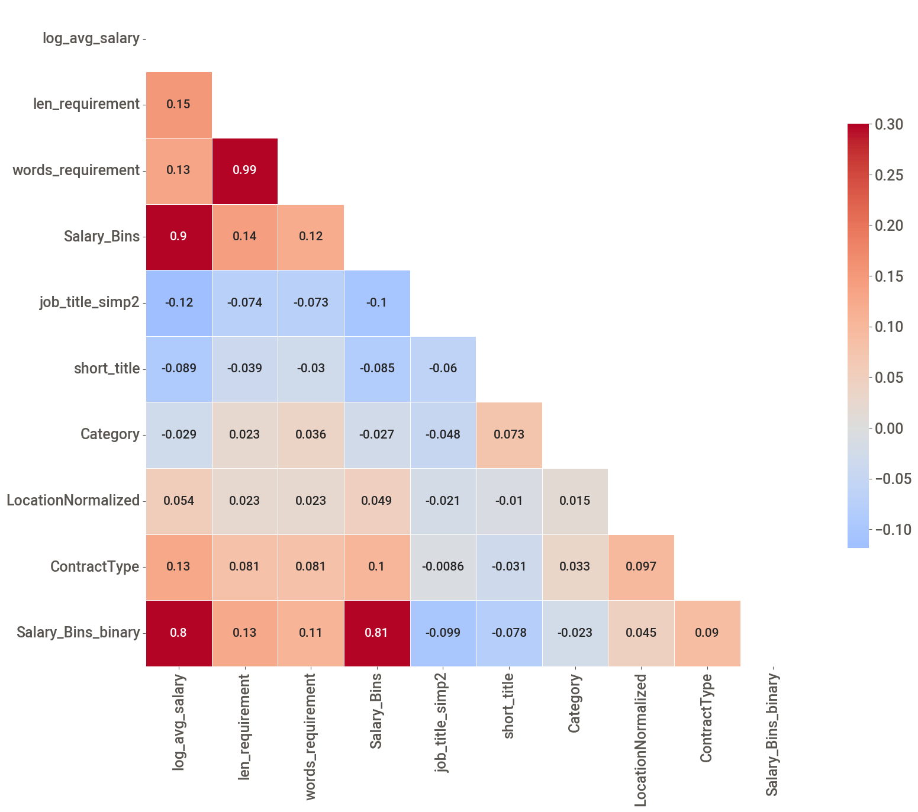
Association check
Not very strong correlation for most of the features to the salary.
Some features are multicollinear like word and characters length in the job description.
Job title and the word length description might have slight influence on the salary.

Slide 14
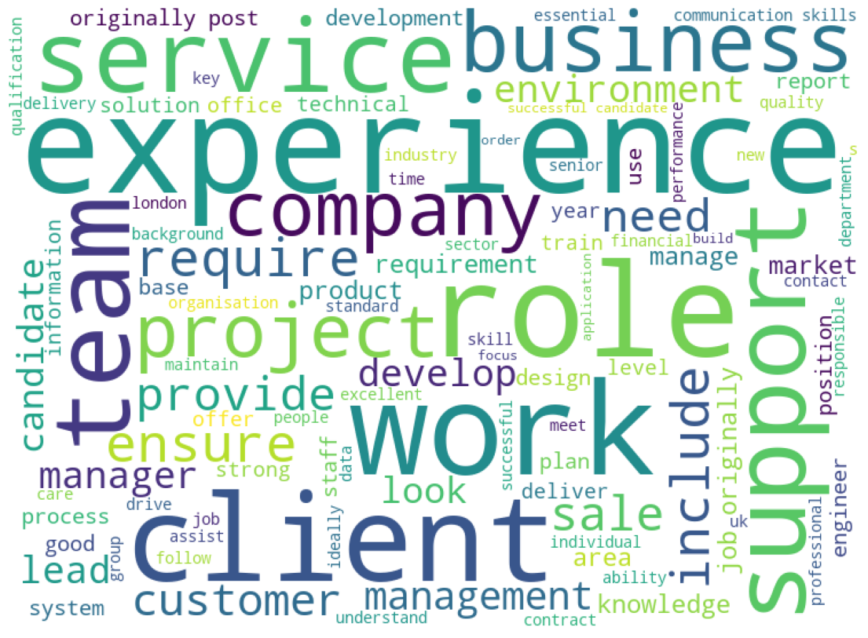
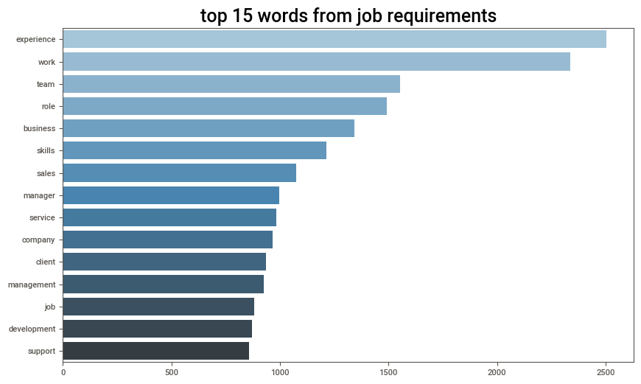
EDA (WORDCLOUD)
Based on the frequency of words, we can see that most jobs require experienced individuals, work, team and business oriented mindset.

Slide 15
Modelling

Slide 16
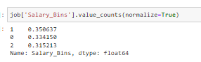
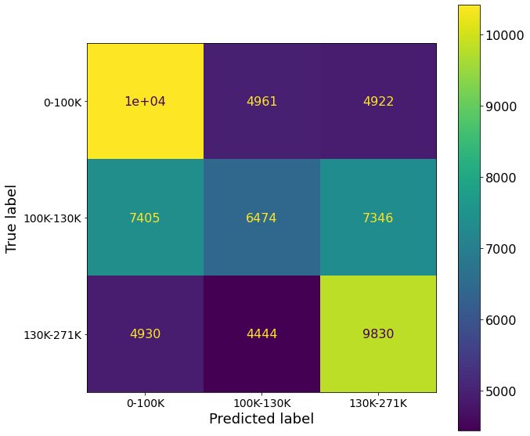
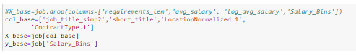
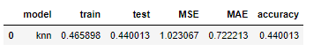
Modelling
Baseline Model
2. Simple EDA feature modelling w/o NLP

Slide 17
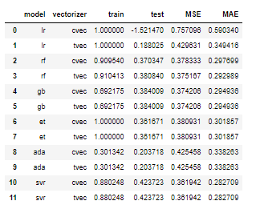
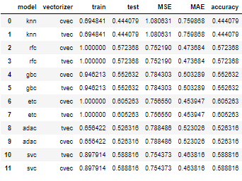
Modelling
3. Regression modelling
4. Classification modelling

Slide 18
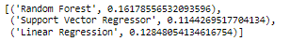
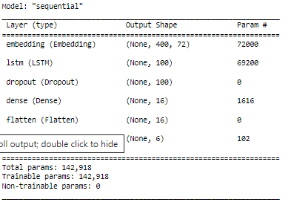
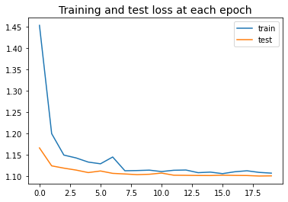
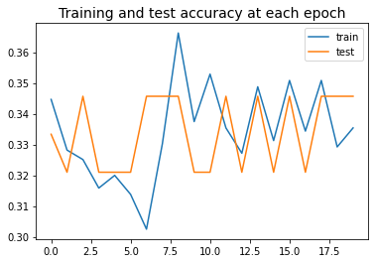
Modelling
5. Word2Vec Model (CBOW)
ACCURACY SCORE
Even though Random forest is the best for word2vec model but it still is underperforming compared to cvec/tfidf models.
6. Deep learning- LSTM model
Accuracy →Train: 0.352, Test: 0.346

Slide 19
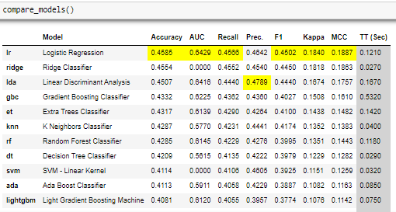
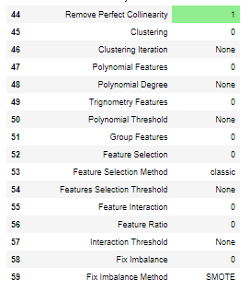
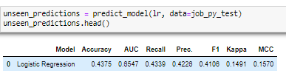
Modelling
5. Pycaret - NLP+ multi-feature modelling

Slide 20
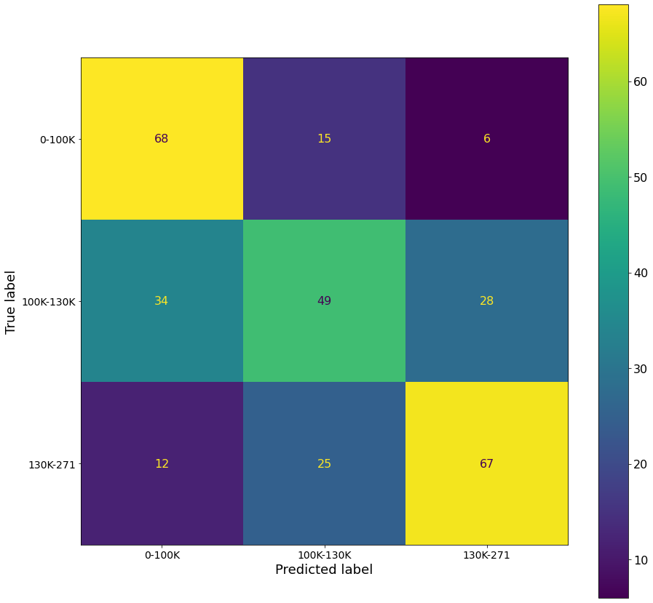
Final Model Selection (ETC)
Overall better performance for MSE/MAE/accuracy in ETC with count vectorizor/tfidf.

Slide 21
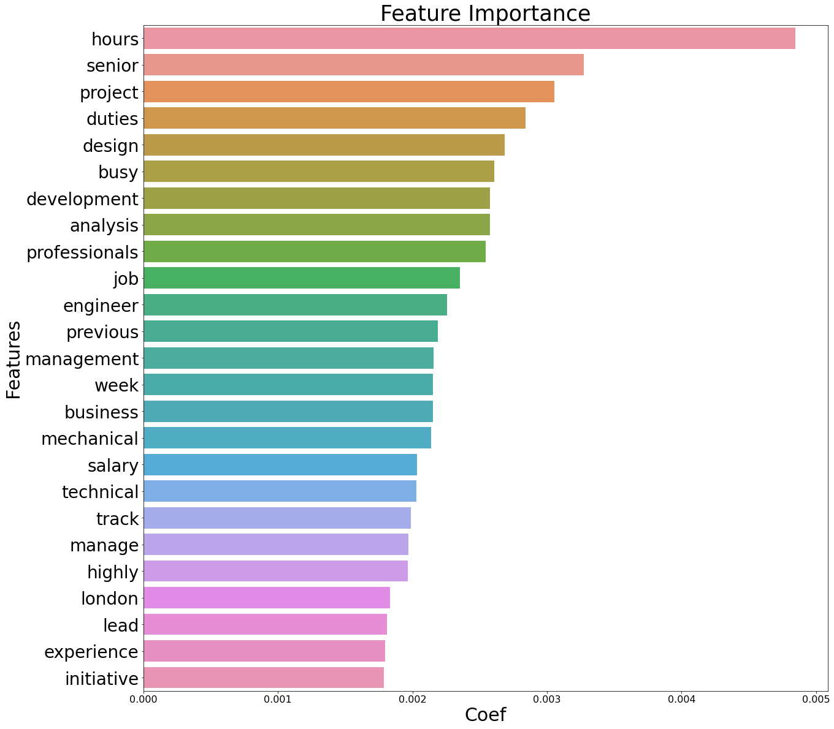
Model Feature Importance
Ranking the job description features by the final model,
We can see that the model predicts the classes when there are keywords such as hours, senior, project etc.

Slide 22
WEB APP INTERFACE

Slide 23
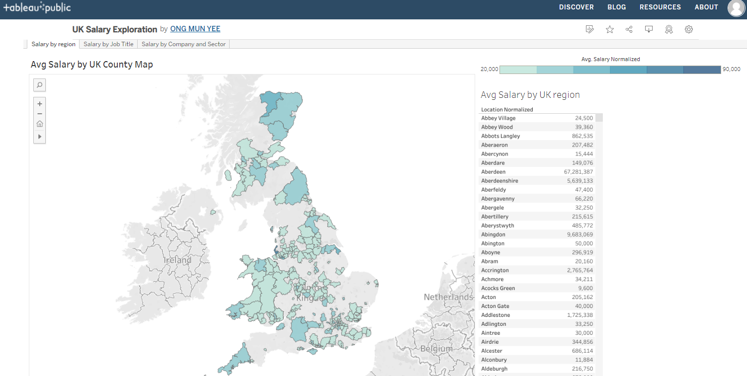
Tableau Deployment
UK Salary Exploration | Tableau Public

Slide 24
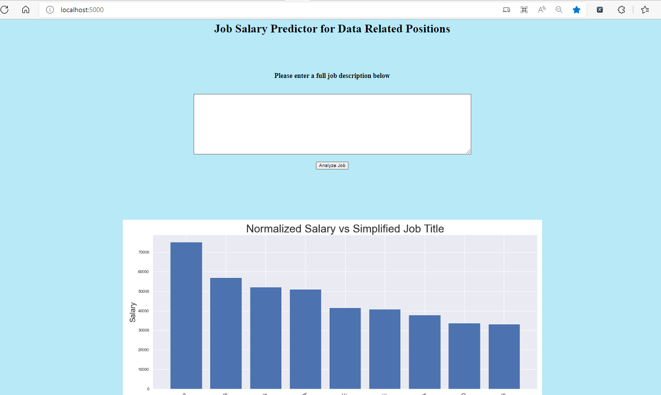
Salary Predictor Application Interface

Slide 25
Conclusion and Recommendation

Slide 26
Recommendations
DATA
Model
Application
Caveat: this is only based on 2013 kaggle dataset in the UK.
Need a more recent data for different countries.
Test on pretrained models like Glove/Bert.
Can include recommendations for the jobs

Slide 27
Conclusion
M
F
A
Model
Features
Application
Based on the MSE, MAE and accuracy, the final model we decided was best for this salary prediction
→ CVEC+ETC (w/o hyperparameter tuning and only on NLP classification)
Despite features like Location, Job position and seniority showing influence on the trend but the job description only NLP classification works best at determining the salary.
The final model was then deployed using flask API and tableau.
From the app, job seekers can enter their resume description and get the range of salary expected.

Slide 28
Thanks all and all the best!

Slide 29
Problem Statement
Performance gap
Vision and objectives
It’s the smallest planet in the Solar System
It’s the farthest planet from the Sun
Requirements
Changes
It’s the biggest planet in the Solar System
It’s a cold place. It’s full of iron oxide dust
Evaluate process
Assess results
It’s composed of hydrogen and helium
Venus has a very poisonous atmosphere

Slide 30
Business Strategies and Frameworks
Stage 1
Stage 2
Stage 3
Stage 4
Stage 5
Stage 6
Pluto is the ninth planet
Venus is the second planet
Jupiter is the fifth planet
Planet Earth is the third
Mars is a very cold place
Company Size
Mercury is the closest planet
Time

Slide 31
Business Strategies and Frameworks
Monitor
Plant
Specialization
It’s the smallest planet in the System
Jupiter is the fifth planet from the Sun
Earth is the third planet from the Sun
Team worker
Complete
Implementer
Despite being red, Mars is a cold place
Uranus is the third biggest planet
The Solar System has eight planets
Investigation
Coordination
Shape
Mercury is the smallest planet
Venus is the second planet from the Sun
Pluto is the ninth planet from the Sun

Slide 32
Business Strategies and Frameworks
Stage 1
Stage 2
Stage 3
Stage 4
Mercury is the closest planet
Mars is a very cold place
Jupiter is the fifth planet
Venus is the second planet
Idea
Examination
Development
Test
Market
It’s the closest planet to the Sun
It’s the ninth planet from the Sun
Despite being red, Mars is cold
It’s the fifth planet from the Sun
It is a ringed planet and a gas giant

Slide 33
Business Strategies and Frameworks
A
D
K
A
R
AWARENESS
DESIRE
KNOWLEDGE
ABILITY
REINFORCEMENT
Mercury is the closest planet to the Sun
Venus is the second planet from the Sun
Jupiter is the biggest planet of them all
Earth is also the third planet from the Sun
Jupiter is also the fifth planet from the Sun

Slide 34
Business Strategies and Frameworks
8
Reinforce
The quantity of iron oxide dust
Don’t Ease Up
7
Mercury is the closest planet
6
Create Short Term Wins
Jupiter is the fifth planet
Enable Authorization
5
Venus has a beautiful name
4
Communicate Buy-In
3
Saturn is the ringed one
Establish Vision
3
3
It’s composed of hydrogen
2
Determine Management
1
Jupiter is the biggest planet
Increase Urgency
1
1
It’s considered a dwarf planet

Slide 35
Business Strategies and Frameworks
Improvement Potential
Current Methods
2
Mercury is the closest planet to the Sun
Mars is the fourth planet from the Sun
1
3
Evaluate New Method
Original Ideas
Venus is the second planet from the Sun
It is the fourth-largest planet by diameter
6
4
Implement Plan
Develop Plan
Jupiter is the biggest planet of them all
It’s the only astronomical object known to harbor life
5

Slide 36
Business Strategies and Frameworks
Task 4
Global
Mars is the fourth planet
Task 1
Mixed
Venus is the second planet
Task 3
Task 2
Local
Planet Earth is the third planet
Jupiter is the fifth planet
Research
Development
Commercialization

Slide 37
Business Strategies and Frameworks
Gate 5
Gate 4
Gate 3
Gate 2
Gate 1
Launch
Analysis
Review
Mercury is the closest planet to the Sun
Development
Neptune is the farthest planet from the Sun
Examination
Saturn is a gas giant and has several rings
Jupiter is a gas giant and the biggest planet
Despite being red, Mars is actually a cold place

Slide 38
Business Strategies and Frameworks
Stage 1
Stage 3
Stage 5
Stage 7
Despite being red, Mars is a cold place
It’s the closest planet to the Sun
Saturn is the ringed one. It has rings
Pluto is considered a dwarf planet
Stage 2
Stage 4
Stage 6
Stage 8
It’s a gas giant and the biggest planet
Venus has a very beautiful name
Earth is the planet where we live on
Neptune is the farthest planet

Slide 39
Business Strategies and Frameworks
Resources
Structure
Mercury is the closest planet to the Sun
2
Neptune is the farthest planet from the Sun
1
Six Boxes
3
Capacity
Information
Despite being red, Mars is a cold place
6
Saturn is a gas giant and has several rings
Motives
5
4
Knowledge
Jupiter is a gas giant and the biggest planet
Venus has a beautiful name, but it’s hot

Slide 40
Business Strategies and Frameworks
Process
Sophisticated
Initial
Managed
Defined
Quantitative
Optimizing
Despite being red, Mars is a cold place. It’s full of iron oxide dust
Venus has a beautiful name and is the second planet from the Sun
The closest planet to the Sun and the smallest of them all
Maturity
Jupiter is a gas giant and the biggest planet in the Solar System
Saturn is composed of hydrogen and helium and is the ringed one
Immaturity

Slide 41
Business Strategies and Frameworks
Stage 2
Stage 4
Venus has a beautiful name and is the second planet from the Sun in the Solar System
Mercury is the closest to the Sun and the smallest one. It was named after a Roman deity
Stage 1
Stage 3
Stage 5
Planet Saturn is the ringed one. It’s made of hydrogen and helium. It has several rings
Despite being red, Mars is a very cold place. It is full of iron oxide dust. It was named after a god
Venus has a beautiful name and is the second planet from the Sun in the Solar System

Slide 42
Business Strategies and Frameworks
Risk management
Communications
Policies and standards
Legal
Fiscal management
Lifecycle Development
Testing and validation
Support and documentation
Procurement
Training
Gate 5
Optimize
Gate 4
Manage
Gate 3
Define
Gate 2
Repeat
Gate 1
Initial

Slide 43
Business Strategies and Frameworks
Identify Performance
Mercury is the closest planet to the Sun
01
Set Objectives
It’s the farthest planet from the Sun
06
02
Requirements
Despite being red, Mars is a cold place
Replace Process
05
03
Saturn is a gas giant and has several rings
Evaluate Process
04
Jupiter is a gas giant and the biggest planet
Assess Results
Venus has a beautiful name, but it’s hot

Slide 44
Business Strategies and Frameworks
Step 6
Mature
Mercury is the smallest planet of them all
Step 5
Optimize
Neptune is the farthest planet from the Sun
Step 4
Manage
Saturn is composed of hydrogen and helium
Step 3
Define
Jupiter is a gas giant and the biggest planet
Step 2
Repeatable
Despite being red, Mars is a very cold place
Step 1
Initial
Venus is the second planet from the Sun

Slide 45
Business Strategies and Frameworks
Optimizing
Managed
Implemented
Defined
Ad hoc
Despite being red, Mars is actually a cold place
Jupiter is a gas giant and also the biggest planet
Saturn is a giant made of hydrogen and helium
Neptune is the farthest planet from the Sun
Venus is the second planet from the Sun

Slide 46
Business Strategies and Frameworks
1
2
3
4
5
Initial Examination
Detail Examination
Development Procedure
Test and Validate
Market launch and Review
It's the closest planet to the Sun
Despite being red, Mars is a cold place
It's a gas giant and the biggest planet
Venus has a beautiful name
Earth is the only planet with life
Gate 1
Gate 2
Gate 3
Gate 4
Gate 5

Slide 47
Business Strategies and Frameworks
Resources
Structure
It’s the smallest planet in the Solar System
It’s the farthest planet from the Sun
Capacity
Six Boxes
Information
It’s the biggest planet in the Solar System
It’s a cold place. It’s full of iron oxide dust
Motives
Knowledge
It’s composed of hydrogen and helium
Venus has a very poisonous atmosphere

Slide 48
Business Strategies and Frameworks
Thought Oriented
People Oriented
Action Oriented
Monitor
Team Worker
Complete
Despite being red, Mars is a cold place
Venus has a very beautiful name
Neptune is the farthest planet
Specialist
Resource Investigator
Implementer
Saturn is the ringed one. It has rings
It’s the closest planet to the Sun
It’s a gas giant and the biggest planet
Plant
Coordinator
Shape
Earth is the planet where we live on
Pluto is considered a dwarf planet
Saturn is the sixth planet from the Sun

Slide 49
Business Strategies and Frameworks
Neptune is the farthest planet from the Sun
Jupiter is a gas giant and the biggest planet
Saturn is the ringed one. It’s mostly hydrogen
Venus is the second planet from the Sun
Despite being red, Mars is a cold place
Time
Initial
Managed
Defined
Quantitative
Optimizing
Process

Slide 50
Business Strategies and Frameworks
Primary Activities
Support Activities
Inbound Logistics
Despite being red, Mars is a very cold place
Mercury is the closest planet to the Sun and very hot
Firm Infrastructure
Operations
It’s a gas giant and it’s also the biggest planet
Venus has a beautiful name and is the second planet
Human Resources
Outbound Logistics
Neptune is the farthest planet from the Sun
Saturn is the ringed one. It’s mostly hydrogen and helium
Technology Development
Marketing and Sales
Earth is the planet where we live on now
Pluto is now considered a dwarf planet
Procurement

Slide 51
Business Strategies and Frameworks
Legal
Environmental
Step 6
Venus is a planet with a beautiful name
Mercury is the closest planet to the Sun
Step 5
Step 4
Technological
Social
Despite being red, Mars is a cold place
Step 3
Neptune is the farthest planet from the Sun
Step 2
Economic
Political
Saturn is a gas giant and has rings
Jupiter is a gas giant and the biggest planet
Step 1

Slide 52
Business Strategies and Frameworks
Step 1
Step 2
Mercury is the closest planet to the Sun and the smallest
Saturn is a gas giant planet and has several rings
1
2
Step 6
Step 3
6
6 Steps
Neptune is actually the farthest planet from the Sun
Jupiter is a gas giant and the biggest planet of them all
3
Step 5
5
Step 4
4
Venus has a beautiful name and a poisonous atmosphere
Despite being red, Mars
is a cold place

Slide 53
Business Strategies and Frameworks
Mercury is the closest planet to the Sun
Despite being red, Mars is a cold place
Jupiter is the fifth planet from the Sun
It’s the farthest from the Sun
1
2
3
4
Initial
Defined
Managed
Mature

Slide 54
Business Strategies and Frameworks
Initial
Managed
Defined
Quantitative
Optimizing
Despite being red, Mars is a cold place
Venus is the second planet from the Sun
Jupiter is the fifth planet from the Sun
Mercury is the closest planet to the Sun
Planet Earth is the third planet from the Sun
Stage 1
Stage 2
Stage 3
Stage 4
Stage 5

Slide 55
Business Strategies and Frameworks
Decline
Step 5
It’s the farthest planet from the Sun
Reinvention
Step 4
Earth is the planet where we live on
Step 3
Maturity
Mercury is the closest planet to the Sun
Step 2
Growth
Despite being red, Mars is a cold place
Step 1
Introduction
It's the biggest planet in the Solar System

Slide 56
Business Strategies and Frameworks
Resources
Mercury is the closest planet to the Sun
01
Structure
Neptune is the farthest planet from the Sun
06
02
Capacity
Six Boxes
Despite being red, Mars is a cold place
Information
Saturn is a gas giant and has several rings
05
03
Motives
Jupiter is a gas giant and the biggest planet
04
Knowledge
Venus has a beautiful name, but it’s hot

Slide 57
Instructions for use (free users)
In order to use this template, you must credit Slidesgo by keeping the Thanks slide.
You are allowed to:
Modify this template.
Use it for both personal and commercial purposes.
You are not allowed to:
Sublicense, sell or rent any of Slidesgo Content (or a modified version of Slidesgo Content).
Distribute this Slidesgo Template (or a modified version of this Slidesgo Template) or include it in a database or in any other product or service that offers downloadable images, icons or presentations that may be subject to distribution or resale.
Use any of the elements that are part of this Slidesgo Template in an isolated and separated way from this Template.
Delete the “Thanks” or “Credits” slide.
Register any of the elements that are part of this template as a trademark or logo, or register it as a work in an intellectual property registry or similar.
For more information about editing slides, please read our FAQs or visit Slidesgo School:
https://slidesgo.com/faqs and https://slidesgo.com/slidesgo-school

Slide 58
Instructions for use (premium users)
In order to use this template, you must be a Premium user on Slidesgo.
You are allowed to:
Modify this template.
Use it for both personal and commercial purposes.
Hide or delete the “Thanks” slide and the mention to Slidesgo in the credits.
Share this template in an editable format with people who are not part of your team.
You are not allowed to:
Sublicense, sell or rent this Slidesgo Template (or a modified version of this Slidesgo Template).
Distribute this Slidesgo Template (or a modified version of this Slidesgo Template) or include it in a database or in any other product or service that offers downloadable images, icons or presentations that may be subject to distribution or resale.
Use any of the elements that are part of this Slidesgo Template in an isolated and separated way from this Template.
Register any of the elements that are part of this template as a trademark or logo, or register it as a work in an intellectual property registry or similar.
For more information about editing slides, please read our FAQs or visit Slidesgo School:
https://slidesgo.com/faqs and https://slidesgo.com/slidesgo-school

Slide 59
Infographics
You can add and edit some infographics to your presentation to show your data in a visual way.
Choose your favourite infographic and insert it in your presentation using Ctrl C + Ctrl V or Cmd C + Cmd V in Mac.
Select one of the parts and ungroup it by right-clicking and choosing “Ungroup”.
Change the color by clicking on the paint bucket.
Then resize the element by clicking and dragging one of the square-shaped points of its bounding box (the cursor should look like a double-headed arrow). Remember to hold Shift while dragging to keep the proportions.
Group the elements again by selecting them, right-clicking and choosing “Group”.
Repeat the steps above with the other parts and when you’re done editing, copy the end result and paste it into your presentation.
Remember to choose the “Keep source formatting” option so that it keeps the design. For more info, please visit Slidesgo School.

